Slide 1
Cloud Computing Md. Alamgir Hossain Senior Lecturer, Dept. of CSE, Prime University Mail: alamgir.cse14.just@gmail.com

Slide 2

Cloud Computing
In 1965, Corbato et al. provide a business model for on-demand computing resources that are based on pay-as-you-go manner - which means customers get to choose whatever resources (like- CPUs, memory, bandwidth, platforms, etc) from the vendor.
Cloud computing developed in 2005/2006 as a new distributed computing model with the aim of attaining computing as a utility like public users obtain services from traditional public utility services such as water, electricity, gas, and telephone.

Slide 3
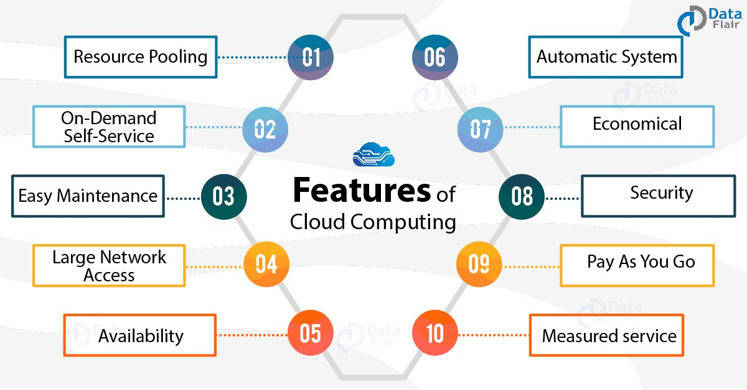
Characteristics of Cloud Computing

Slide 4
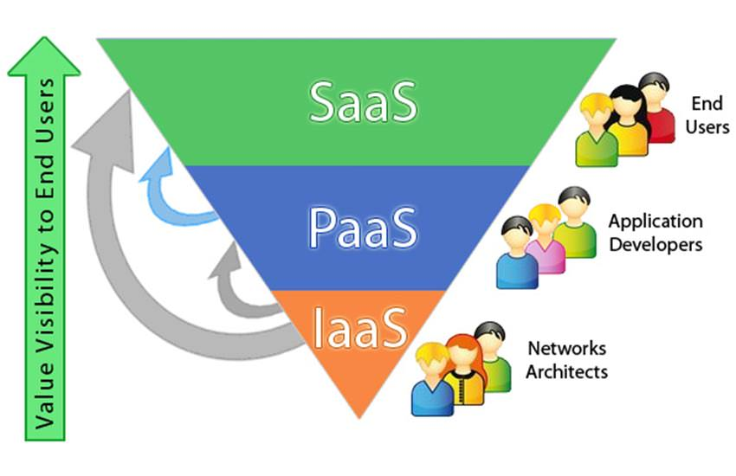
Service Model of Cloud Computing

Slide 5
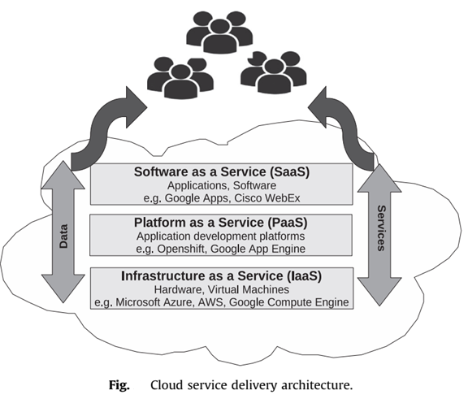
Service Model of Cloud Computing

Slide 6
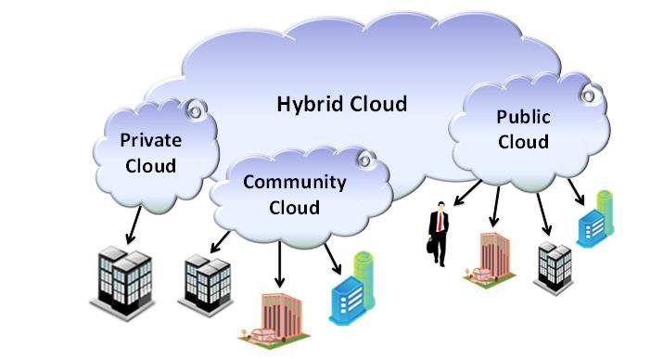
Deployment Model of Cloud Computing

Slide 7
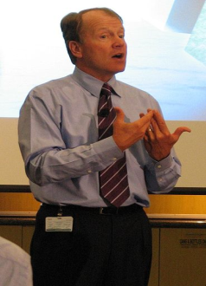
Challenges of Cloud Computing
Security and Privacy
Interoperability and portability
Reliability and availability
Performance and bandwidth cost
SLA & service quality
Lack of knowledge and expertise
Recovery and loss of data
Vendor Lock-in
Cloud Computing is a security nightmare and it can’t be handled in traditional ways.
John Chambers
Former CISCO CEO

Slide 8
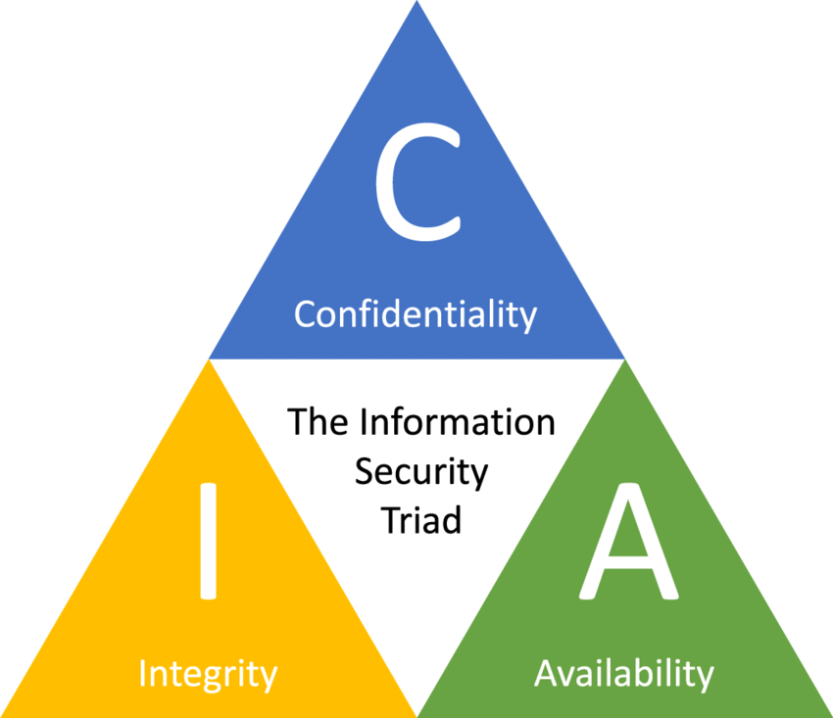
Security Triad of Cloud Computing

Slide 9
Why Cloud Computing brings new threats?
Traditional system security mostly means keeping bad guys out.
The attacker needs to either compromise the auth/access control system, or impersonate existing users.
Cloud Security problems are coming from:
Loss of control
Lack of trust (mechanisms)
Multi-tenancy

Slide 10
Why Cloud Computing brings new threats?
Consumer’s loss of control:
Data, applications, resources are located with provider.
User identity management is handled by the cloud.
User access control rules, security policies and enforcement are managed by the cloud provider.
Consumer relies on provider to ensure-
Data security and privacy
Resource availability
Monitoring and repairing of services/resources

Slide 11
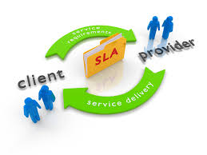
Why Cloud Computing brings new threats?
The on-demand service or utility-based economic model necessitates the use of well-established service level agreements (SLAs).
An SLA is a part of a service contract between the consumer and provider that formally defines the level of service. It records a common understanding of services, priorities, responsibilities, guarantees, and warranties.
Therefore, the main issue for
cloud computing is to build
a new layer to support a contract
negotiation phase between service
providers and consumers and to
monitor contract enforcement for
building trust to the clients.

Slide 12
Why Cloud Computing brings new threats?
Multi-tenancy :
Multiple independent users share the same physical infrastructure
So, an attacker can legitimately be in the same physical machine as the target

Slide 13
Security Issues of Cloud Computing
A security issue is something happening in any assets attacks, misconfiguration, fault, damage, loopholes, and weakness in the system.
The security issues may be categorized in eight parts as:
i) Data storage and computing security issues,
ii) Virtualization security issues,
iii) Internet and services related security issues,
iv) Network security issues,
v) Access control issues,
vi) Software security issues,
vii) Trust management issues &
viii) Compliance and legal aspects.

Slide 14
BOT
A malware instance that runs autonomously and automatically on a compromised computer (zombie) without owner’s consent.
Profit-driven, professionally written, widely propagated.
You might have seen or experience them before in chat rooms, online games, etc.

Slide 15
BOTNeT
Botnet (Bot Army): network of bots controlled by criminals.
A Botnet is a network of compromised computers under the control of a remote attacker.
Definition: “A coordinated group of malware instances that are controlled by a botmaster via some C&C channel”.
Coordinated: do coordinated actions
Group: yes, it’s a group of bots!
Botmaster: meet the cybercriminal
C&C channel: command and control channel

Slide 16
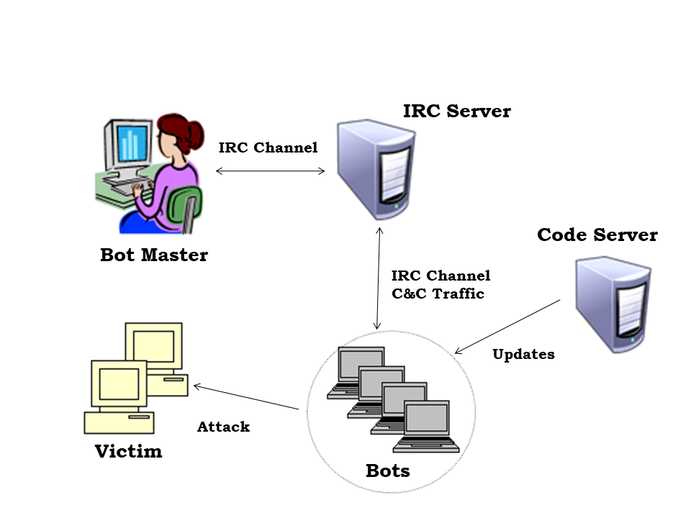
BOTNeT

Slide 17
BOTNeT
According to a study in 2018 by Incapsula, more than 61 percent of all Web traffic is now generated by bots.
“25% of Internet PCs are part of a botnet!” ( - Vint Cerf, one of the Internet Pioneer in USA)
It’s a real threat!

Slide 18
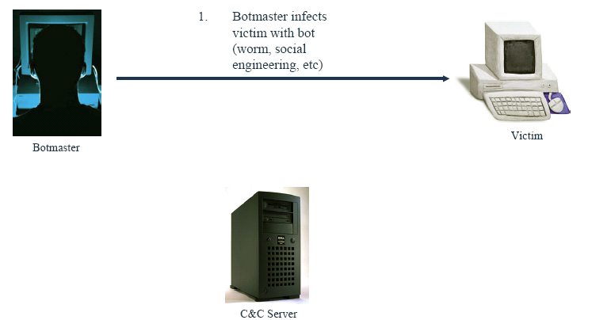
BOTNeT: Life Cycle

Slide 19
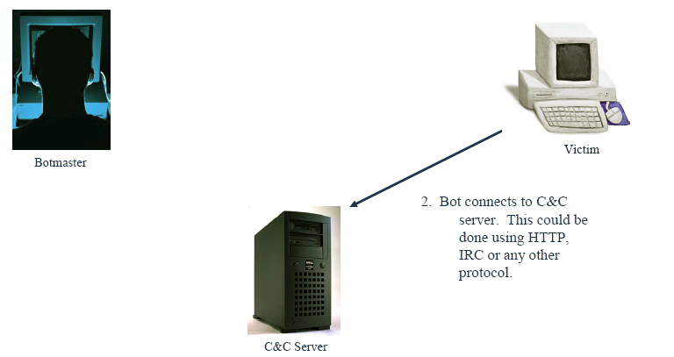
BOTNeT: Life Cycle

Slide 20
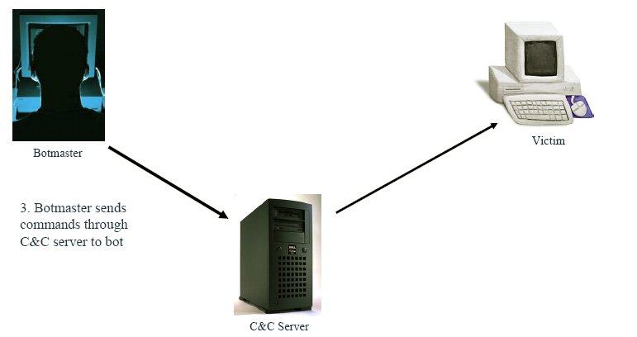
BOTNeT: Life Cycle

Slide 21
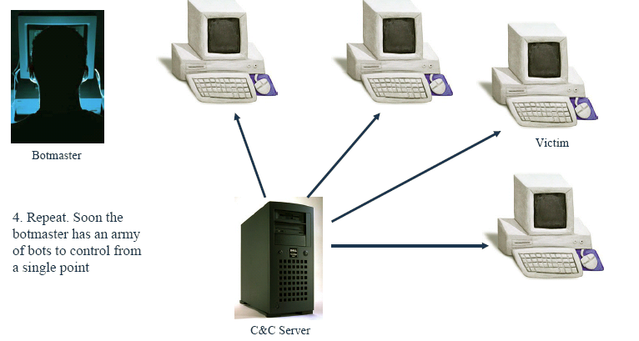
BOTNeT: Life Cycle

Slide 22
List of BOTNeT
Zeus (3.6 million)
Koobface (2.9 million)
TidServ (1.5 million)
Trojan.Fakeavalert (1.4 million)
TR/DIdr.Agent.JKH (1.2 million)
Monkif (520,000)
Hamweq (480,000)
Swizzor (370,000)
Gammima (230,000)
Conficker (210,000)

Slide 23
How is Botnet Used?
Distributed Denial of Service (DDoS) attacks
Sending Spams
Phishing (fake websites)
Addware (Trojan horse)
Spyware (keylogging, information harvesting)
Click Fraud

Slide 24
Botnet Detection
Two approaches for botnet detection based on:
Setting up honeynets
Passive traffic monitoring
Signature based
Anomaly based
DNS based
Mining based

Slide 25
Thank You

